Slide 1
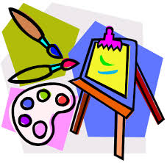
Art Week
22.6.20

Slide 2
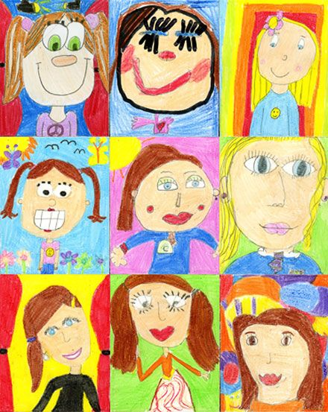
Learning Challenge 1
This week we would like you to draw a self portrait.
This will then be used to form a class collage which all children will get a copy of.
We would like you to draw or paint the picture on A4 paper.
All pictures will need to be uploaded to Class Teams by
Friday 3rd July.

Slide 3
What is a self –portrait?
A self-portrait is a representation of an artist that is drawn, painted, photographed, or sculpted by that artist.

Slide 4
Self - portrait lesson
The following slides will have some resources you might want to look at before you begin to draw.
BBC lesson - Video clip and support
Youtube Lesson -Video 1
Youtube lesson - Video 2

Slide 5
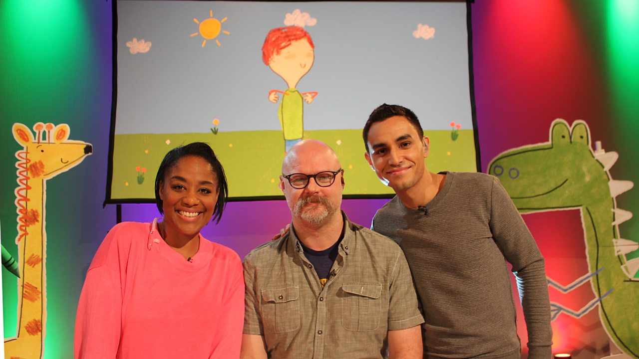
Live Lesson with Pablo
You can draw along here to practice your self portraits.
Live Lesson

Slide 6
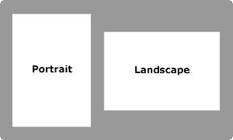
For your final piece
Use a mirror
Sketch in pencil first
Make sure you are using A4 paper in portrait.
Don’t worry if you make mistakes – you
can try again.
Add colour to the picture
Upload your final piece with your first name and surname initial into the files section labelled self portraits by Friday 3rd July.

Slide 7
Learning challenge 2
Research Pablo Picasso.
Create a presentation to share with others about the artist.

Slide 8
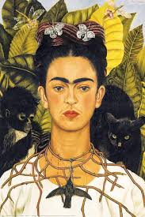
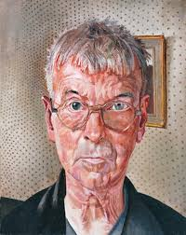
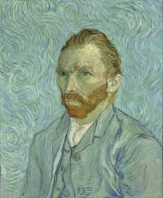
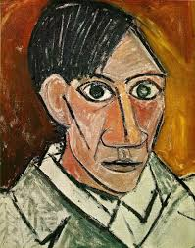
Learning challenge 2
Lots of artists have created self portraits.

Slide 9
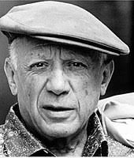
Pablo Picasso
One of the most famous artists that created self portraits was Pablo Picasso.

Slide 10
RESEARCH
We would like you to research Pablo Picasso and his art.
We would then like you to represent the learning you have found.
You could create a poster to teach us about Picasso, a PowerPoint or any other way you wish.
You may want to replicate some of his art.
On the next slide there will be some websites you could use for research.

Slide 11
Website
Picasso on Tate
BBC Bitesize lesson
Picasso

Slide 12
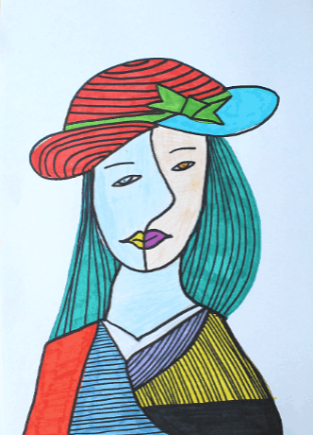
Learning challenge 3
Create an abstract self portrait.

Slide 13
Now you have learnt more about self portraits see if you can create an abstract self portrait. This does not need to be included on the portrait for the class collage.
Here are some links to help you with this,
Abstract Face Art
Picasso Faces

