Slide 1
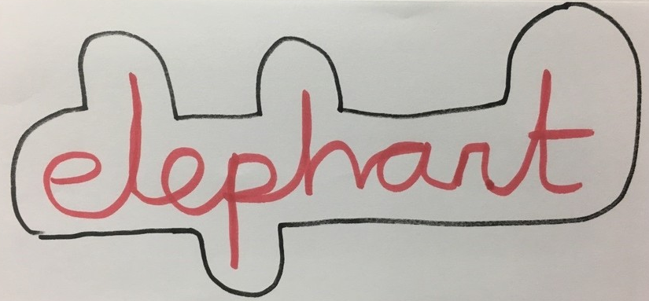
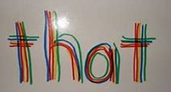
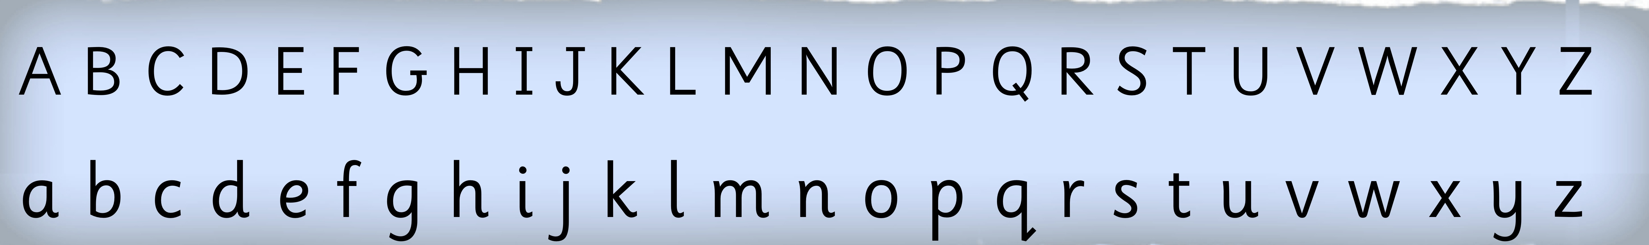
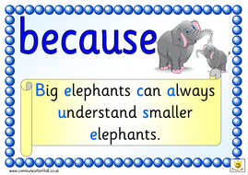
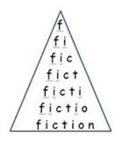

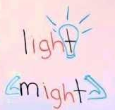
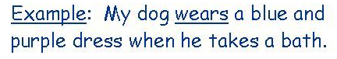
Draw around the shape of the word.
Order your spellings in alphabetical order.
Write the words using rainbow colours.
Create a mnemonic of the word.
Spelling Strategies
Look for words within words:
Shipwreck
ship
hip
wreck
Write the word across and down.
circle
i
r
c
l
e
weight
e
i
g
h
t
heart
e
a
r
t
Write the word in a pyramid.
Create a picture to link with the word.
Write the word in a silly sentence.

